Slide 1
Occupational Specialist Component Content: Digital Production, Design and Development
The T Level T Level Technical Qualification in Digital: Digital Production, Design and Development includes a single Occupational Specialist Component. Therefore, there is a single synoptic assessment for the Occupational Specialist Component, which is an extended ‘design, development and implementation’ project. The synoptic element of the project is important in order to ensure that students are able to demonstrate threshold competence: this is the principal reason why the Occupational Specialism is assessed via a single extended project assessment to ensure that students are able to evidence all the skills required by the Performance Outcomes.
The T Level Technical Qualification in Digital: Digital Production, Design and Development Occupational Specialist Component consists of several activities grouped into four substantive tasks.
Each task will be completed during a window set by Pearson during which you will schedule supervised assessment sessions. In some cases, tasks will also involve opportunities for unsupervised activities where the requirements of the skills being assessed make this necessary.

Slide 2
Learning Objectives
Aims:
To understand how to deploy and maintain a product
Objectives:
To be able to identify how to deploy and maintain a product including:
Install and configure the product
Update the product
Maintain the product
Provide system support
Provide use support
Carry out bug fixing.
Arrange/carry out user training.
Release updates to enhance the product
Understand the value to the organisation of the digital product.
Understand the role of the software development life cycle.

Slide 3
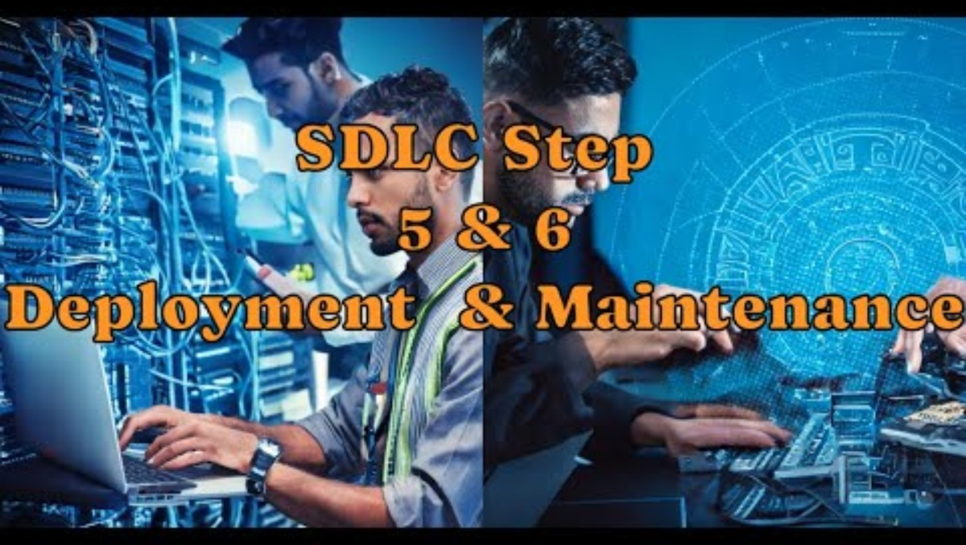
Deployment & Maintenance
This module focuses on the post-development stages of a product—deployment, maintenance, support, and updates—to ensure the product remains functional, valuable, and aligned with user needs.
Intent: To give learners the skills and understanding to manage a product beyond its initial release, including configuration, support, bug fixing, updates, and enhancement.
Tools used:
Trello/Jira (task tracking),
Git,
CI/CD platforms,
system monitoring tools

Slide 4
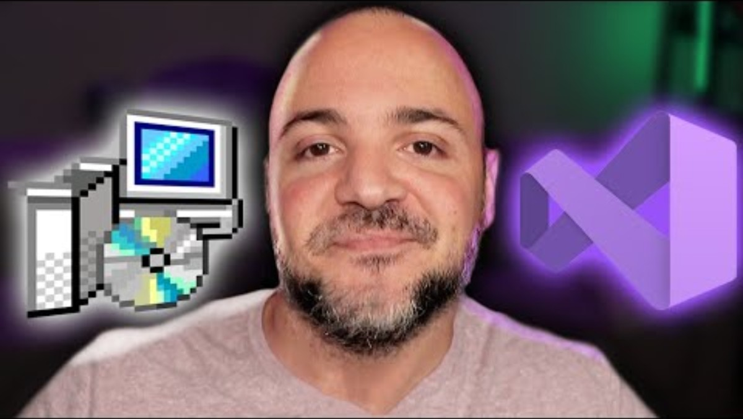
Install and Configure the Product
Installing and configuring a product involves setting it up on production servers or environments so it’s usable by end-users.
Intent: Ensure the product runs reliably and securely in the user’s environment, considering dependencies, permissions, and performance.
Tools used:
Docker, Ansible, Windows Installer
Linux CLI, Apache/Nginx,
Environment Variables (.env)
Notes:
Ship Your Product! Let's Build An Installer In Visual Studio
https://www.youtube.com/watch?v=R7ak_c_ElJw

Slide 5


Update the Product
Product updates include patches, improvements, and new features delivered after deployment.
Intent: Keep the software secure, compatible, and aligned with evolving user or business needs.
Tools used:
Git, Version Control,
CI/CD (GitHub Actions, Jenkins),
Semantic Versioning,
Patch management tools

Slide 6
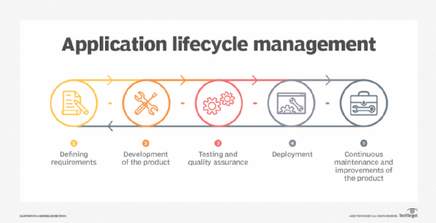
Maintain the Product
Maintenance ensures the product continues to perform as expected over time by managing updates, monitoring performance, and fixing issues.
Intent: Sustain the product’s reliability and extend its useful life.
Common Issues required to keep the product performing
Bug Fixing
Managing Technical Debt
Handling Changing Requirements
Users’ needs evolve, or new business goals arise, requiring updates and new features.
Compatibility Issues
Performance Optimization
Security Vulnerabilities
Documentation Updates
Regression Testing
Dependency Management
Knowledge Transfer and Team Turnover
User Support and Feedback Handling
Resource Constraints
Tools used:
Log monitoring (ELK Stack),
Application Performance Monitoring (New Relic, Datadog),
SLA documents
Notes:
https://www.youtube.com/watch?v=CZPEWct3k5g
https://www.youtube.com/watch?v=fGMqakS_Z_E
Bug Fixing
Identifying, diagnosing, and fixing defects or errors reported by users or discovered through testing.
Managing Technical Debt
Over time, shortcuts or quick fixes accumulate, making the codebase harder to understand and modify.
Handling Changing Requirements
Users’ needs evolve, or new business goals arise, requiring updates and new features.
Compatibility Issues
Ensuring the software continues to work with new versions of operating systems, browsers, hardware, or third-party services/APIs.
Performance Optimization
Addressing slowdowns or resource inefficiencies that appear as the software scales or changes.
Security Vulnerabilities
Continuously updating the software to patch security holes and protect against new threats.
Documentation Updates
Keeping user manuals, code comments, and system documentation accurate and current.
Regression Testing
Verifying that changes or fixes don’t break existing functionality.
Dependency Management
Handling updates or deprecations in third-party libraries, frameworks, or tools the software relies on.
Knowledge Transfer and Team Turnover
Ensuring that new developers can understand and work on the software effectively despite changes in team composition.
User Support and Feedback Handling
Responding to user issues and incorporating feedback into future maintenance cycles.
Resource Constraints
Balancing maintenance needs with budget, time, and staffing limitations

Slide 7
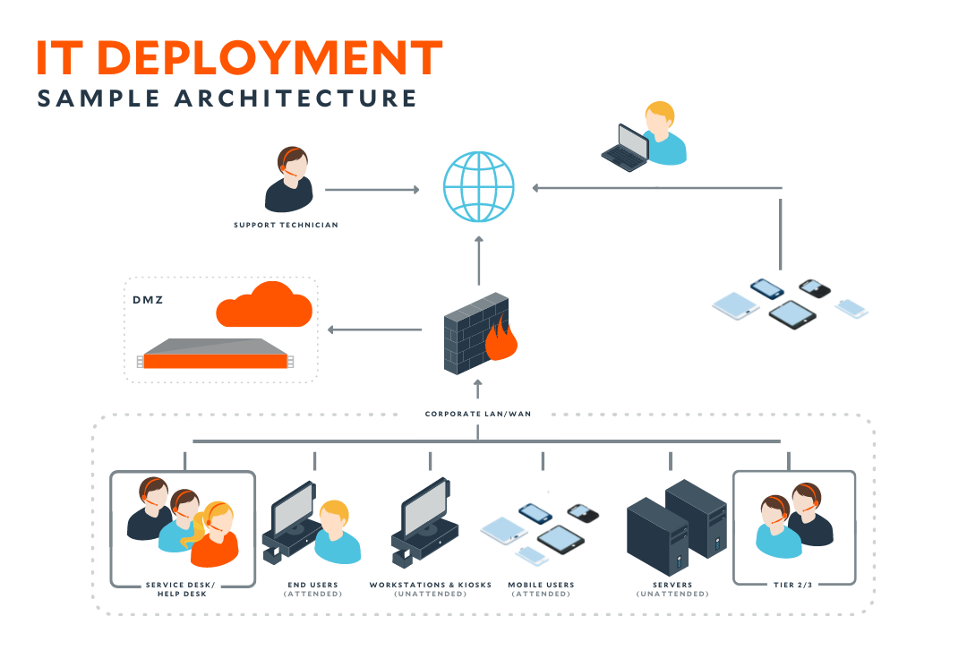

Provide System Support
System support involves handling server-side issues, database management, network concerns, and uptime guarantees.
Intent: Ensure infrastructure stability and resolve technical faults at the system level.
Tools used:
SSH, AWS/Azure portals,
Kubernetes, system logs,
backup tools
Notes:
https://www.beyondtrust.com/blog/entry/what-is-it-support-your-technical-support-tools-and-service-desk-explained
https://www.youtube.com/watch?v=c3QfSmKo4QA

Slide 8
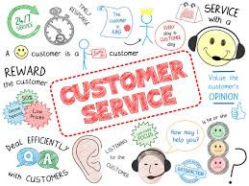
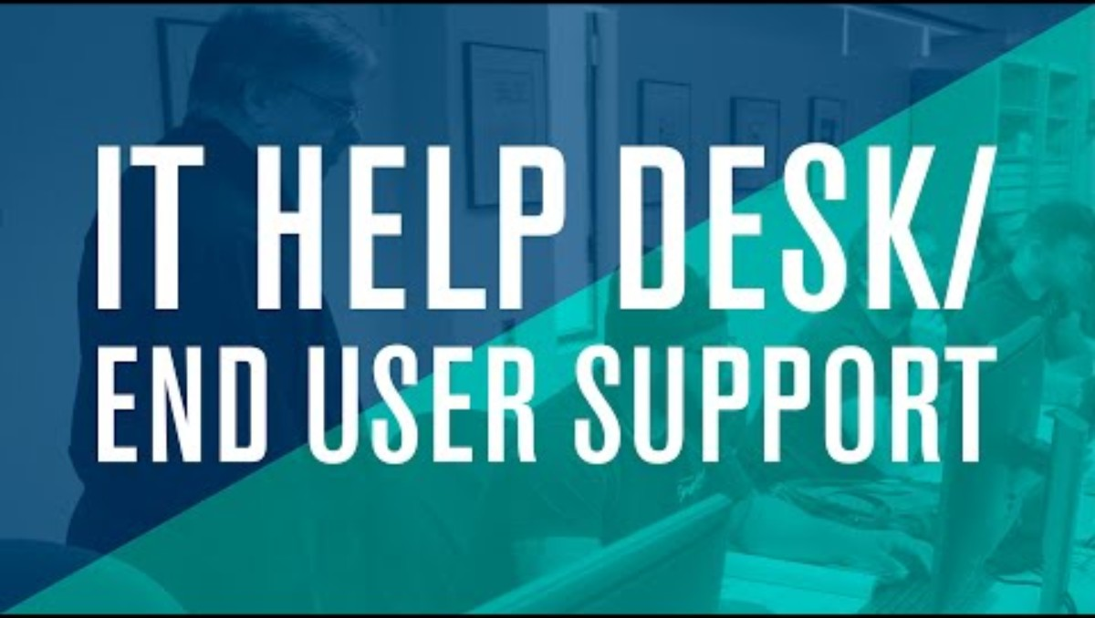
Provide User Support
User support includes helping end-users understand, navigate, and resolve issues with the product.
Intent: Maintain user satisfaction and ensure continued adoption of the product.
Tools used:
Helpdesk platforms (Zendesk, Freshdesk),
FAQ pages, Chatbots,
Email support tools

Slide 9


Carry Out Bug Fixing
Bug fixing is the process of identifying and resolving software defects that affect usability or performance.
Intent: Improve product quality and user trust by addressing faults quickly and effectively.
Tools used:
Jira (bug tracking), Git (issue branches),
Debugging tools (browser dev tools, IDE debuggers),
Postman
Notes:
https://www.youtube.com/watch?v=koyhK1G9haU
ASP.NET CORE MVC | Beginner Tutorial | Emergency Bug Fix #!!!
https://www.youtube.com/watch?v=77O_g-el_Is

Slide 10
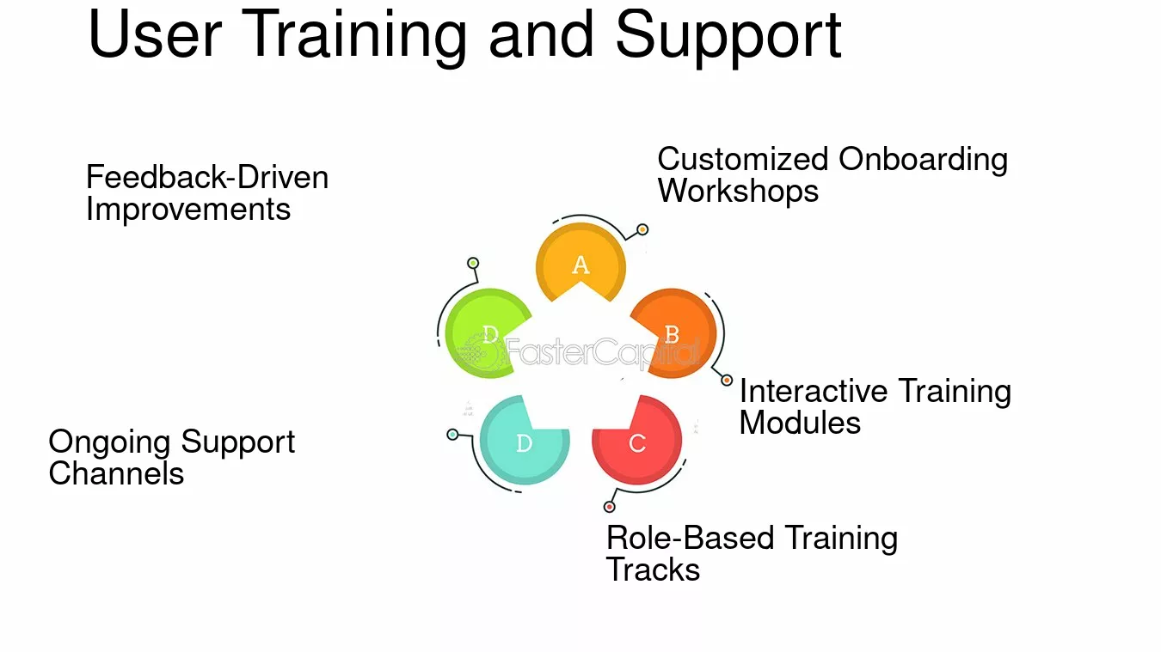

Arrange and Carry Out User Training
User training introduces users to the product and educates them on using its features effectively.
Intent: Improve user confidence, reduce support queries, and increase adoption.
Tools used:
Training manuals, walkthrough videos,
webinars (Zoom, Teams),
Learning Management Systems (LMS)

Slide 11
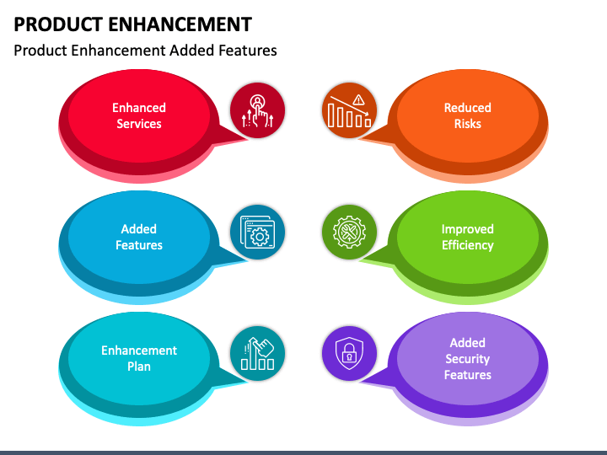
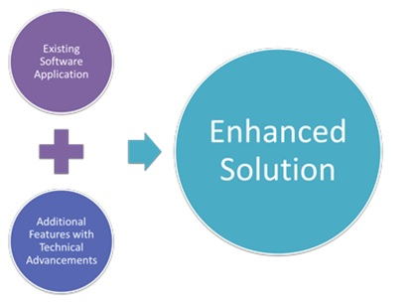
Release Updates to Enhance the Product
Product enhancements involve rolling out new features or optimizations based on feedback and roadmap planning.
Intent: Add value to the product, remain competitive, and better serve user needs.
Tools used:
Release notes, A/B testing tools,
Product feedback tools (UserVoice, Canny),
Feature flags

Slide 12
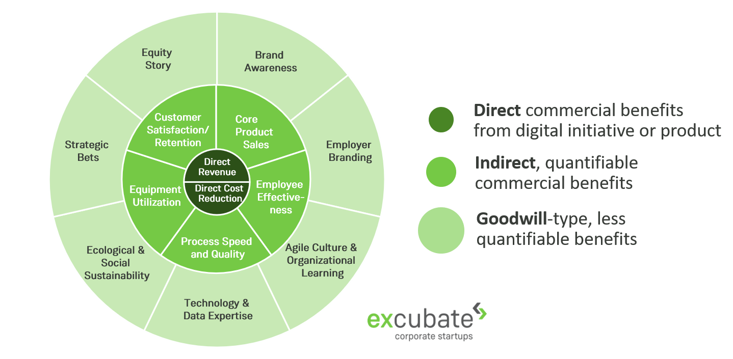
Understand the Value to the Organisation
A successful digital product contributes to operational efficiency, user satisfaction, revenue, or brand value.
The value is multifaceted, encompassing both tangible benefits like revenue generation and cost reduction, as well as intangible benefits such as improved user experience and strategic goal alignment.
The product’s strategic role in helping an organization achieve its business goals.
Tools used:
Analytics (Google Analytics, Mixpanel),
KPIs/Dashboards, ROI calculators
Notes:
https://www.linkedin.com/pulse/value-creation-digital-products-services-canvas-markus-anding

Slide 13
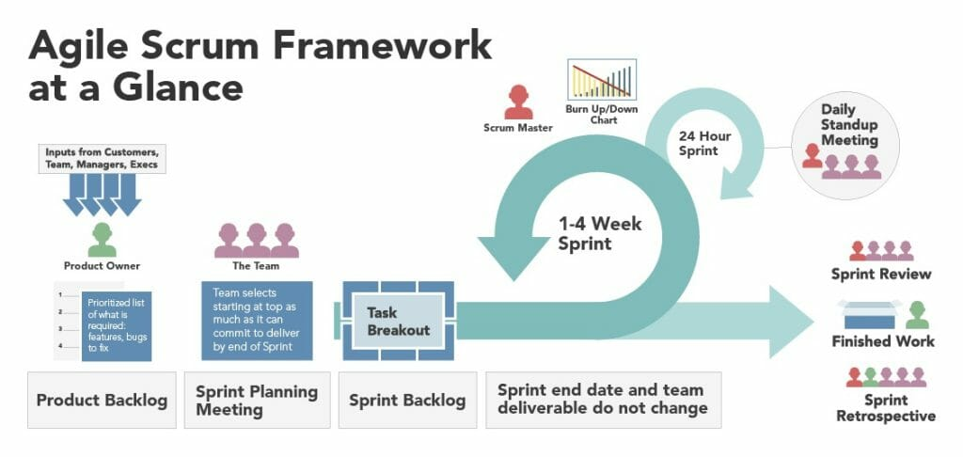
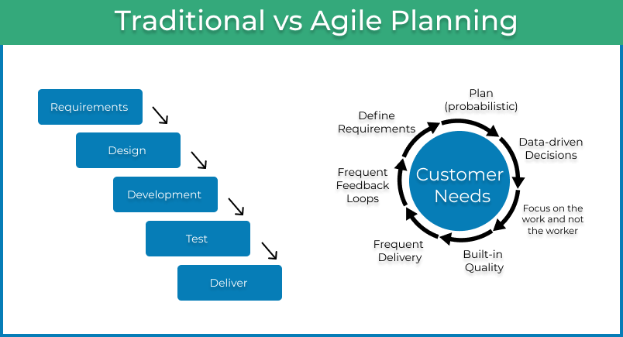
Role of the Software Development Life Cycle (SDLC)
A Software Development Life Cycle (SDLC) is crucial for ensuring high-quality software and efficient project management.
It provides a structured approach to software development, breaking down the process into distinct phases.
Intent: To improve quality, manage risks, and enhance collaboration
Tools used:
Waterfall, Agile, DevOps tools,
SDLC documentation templates

Slide 14
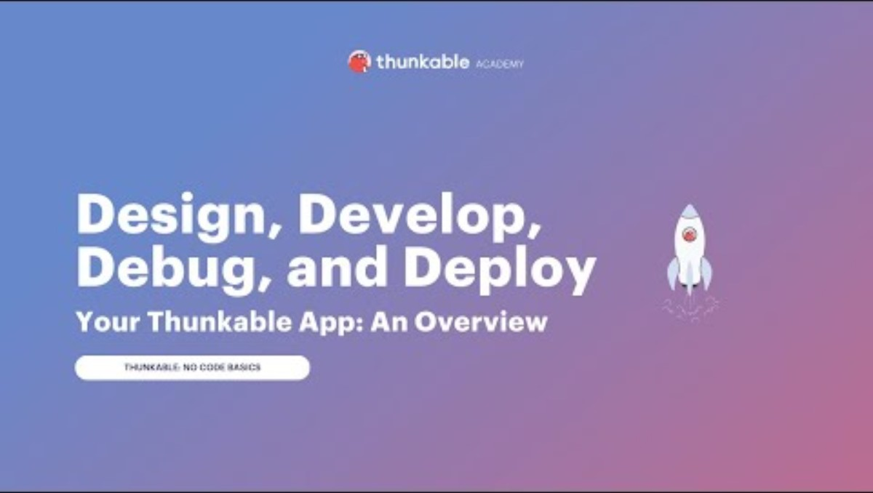
Activity – Deploy & Maintain Your Product
Objective: To simulate the process of deploying and maintaining a product through a hands-on, team-based project.
You Will Learn To:
How to deploy your prototype app
How to maintain your prototype app
How It Works:
Work in teams of 3–5
Deploy a basic prototype
Maintain it (defect or improvements based on feedback
Present your work and share lessons learned
Notes:
The EASIEST Way To Build Your Mobile App In 30 Minutes (No Code)
https://www.youtube.com/watch?v=kqzAaESkNdo
Thunkable App Making Tutorial for Beginners | Build Your Own Mobile Apps Without Code (Demo)
https://www.youtube.com/watch?v=3NZtmKv6ph0
Thunkable 1.5. Share and Publish an App
https://www.youtube.com/watch?v=d_PXXbWdJCo
Design, Develop, Debug, and Deploy Your Thunkable App: An Overview (3 of 3)
https://www.youtube.com/watch?v=e3AXnMVitXM

Slide 15
Activity – Deploy & Maintain Your Product
Objective: Work as a team to deploy and maintain your brand-new digital product — just like real-world designers and developers do.
You’ll go through the key stages of product design, from idea to prototype.
Instructions:
Identify a real-world problem
Come up with a product idea
Design a simple user interface
Plan how the product will work (logic)
Decide what data it needs
Create a basic testing plan
Present your design to the class
Deliverables:
A clear product idea and target users
A sketch or wireframe of the main screen
A basic outline of how your product works (logic)
A list of data requirements
An initial testing plan
A short team presentation
Notes:
Time: 60–90 minutes (including presentations)
Purpose of the Activity
Apply the core stages of product design in a practical, team-based challenge
Strengthen your skills in problem-solving, planning, design thinking, and communication
Understand how designers and developers turn ideas into working products

